Slide 1

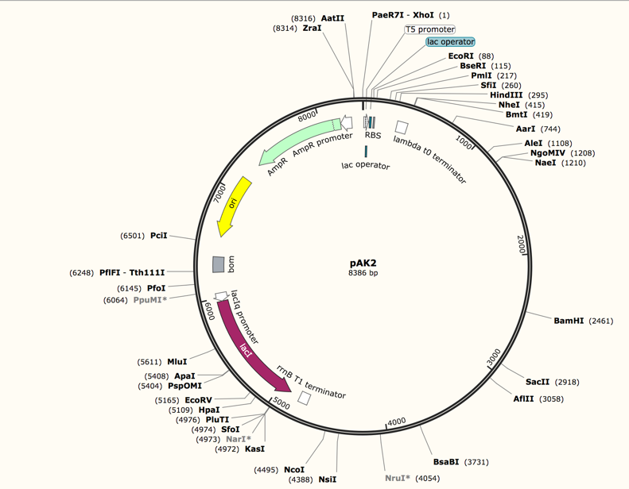
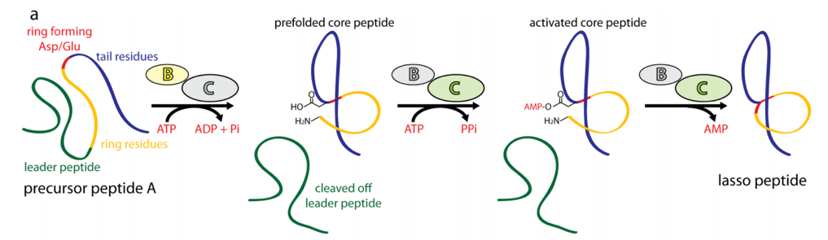
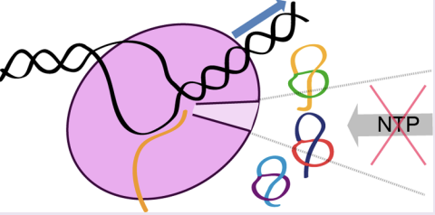
Reconstructing and Expressing a Novel Lasso Peptide Gene Cluster
Angelo Kayser-Browne | Link Lab, Chemical and Biological Engineering | angelok@princeton.edu
Background
Fig. 1: Topology and Gene Cluster Layout
Fig. 2: Gene Cluster Reconstruction
Lasso peptides are a type of RiPP (ribosomally synthesized and post-translationally modified peptide) produced by various bacterial strains
Lasso peptides are found in biosynthetic gene clusters which contain a precursor peptide along with several related proteins that modify the peptide and give it its unique “lariat knot” structure
Many previously investigated lasso peptides have shown antimicrobial effects through inhibition of RNA polymerase, an essential enzyme for cell survival^{1, 2}
This project focused on one particular lasso peptide gene cluster found in a strain of gut bacteria. The lasso peptide of interest has notable similarities with antimicrobial lasso peptides and may have the same function.
Conclusion
Although time was limited and the peptide and associated proteins could not be studied in depth, the project has provided a way for them to be reliably expressed in large quantities, providing the opportunity for future research on structure and function to be performed.
Techniques such as nuclear magnetic resonance can be used to elucidate the structure of the novel peptide and compare it to other members of the lasso peptide family
Antimicrobial activity can be gauged in order to determine medical relevance and better understand lasso peptide-RNA polymerase interactions
Based on effectiveness as an antibiotic, this peptide and closely related lasso peptides may provide a solution to various infectious diseases in an era of growing antibiotic resistance and “superbugs”
Defining lariat knot structure of a lasso peptide.
A model lasso peptide gene cluster. Note that this gene cluster has the same A-D format as the novel gene cluster.
Visualization of pAK2, the plasmid containing the Enterobacter lasso peptide gene cluster. This plasmid is used to transform E. coli and induce heterologous expression of the genes of interest.
Fig. 3: Post-Translational Modifications
Research Motive
Maturation pathway of the lasso peptide precursor after translation. The leader sequence is cleaved off by enzyme B, and the remaining core peptide is locked into its lariat knot conformation by an isopeptide bond formed by enzyme C. Some lasso peptide gene clusters also have a D protein which exports the peptide into the extracellular environment.
The lasso peptide of interest may have potential as an effective antibiotic against certain Enterobacter strains which are responsible for disease and frequently antibiotic-resistant
However, the gene cluster had never been expressed before, meaning that direct research on the lasso peptide could not be performed up to this point
In order to allow further investigation, we set out to express the peptide and its associated proteins in a lab setting
Fig. 4: Interactions with RNA Polymerase
Acknowledgments
I would like to thank my mentor, Larry So, my PI, Professor Jamie Link, and the members of the Link Lab as a whole for their support of my research project and my personal development as a researcher .
Many antimicrobial lasso peptides inhibit RNA polymerase by ”clogging” the RNAP secondary channel. Because the secondary channel provides an entrance for the NTPs needed to fuel transcription, this RNAP inhibition prevents transcription, eventually killing the target cell. Because of its similarities to other antimicrobial lasso peptides, the Enterobacter peptide is suspected to have the same inhibitory behavior.
References
Methods and Materials
1) Cheung-Lee, Wai Ling, et al. “Discovery and Structure of the Antimicrobial Lasso Peptide Citrocin.” Journal of Biological Chemistry, vol. 294, no. 17, 2019, pp. 6822–6830., doi:10.1074/jbc.ra118.006494
2) Metelev, Mikhail, et al. “Acinetodin and Klebsidin, RNA Polymerase Targeting Lasso Peptides Produced by Human Isolates of Acinetobacter Gyllenbergii and Klebsiella Pneumoniae.” ACS Chemical Biology, vol. 12, no. 3, 2017, pp. 814–824., doi:10.1021/acschembio.6b01154.
Fig. 1: Maksimov, M. O., et al. “Precursor-Centric Genome-Mining Approach for Lasso Peptide Discovery.” Proceedings of the National Academy of Sciences, vol. 109, no. 38, 2012, pp. 15223–15228., doi:10.1073/pnas.1208978109.
Fig. 3: Julian D. Hegemann, Marcel Zimmermann, Xiulan Xie, and Mohamed A. Marahiel. “Lasso Peptides: An Intriguing Class of Bacterial Natural Products.” Accounts of Chemical Research 2015 48 (7), 1909-1919 DOI: 10.1021/acs.accounts.5b00156
Fig. 4: See citation 2
Custom DNA fragments were combined and replicated in order to form each gene
Genes were inserted into a vector in stages in order to reconstruct the lasso peptide gene cluster
E. coli XL1 cells were transformed with each plasmid in order to clone genes of interest
E coli BL21 cells were transformed with the finalized plasmid in order to induce gene cluster expression
High-performance liquid chromatography and liquid chromatography mass spectrometry were used to isolate and identify the target peptide
Results
The Enterobacter gene cluster and its constituent genes were identified and amino acid sequences were determined. Precursor peptide sequence can be seen below:
MDVKNKHALTQRNEKALNAVSITRIPVKASKITR | GHSVDRIPE | YFGPPLPGPVLFYS
Leader Sequence. Ring Residues Loop + Tail Residues
A finalized plasmid, pAK2, containing genes A through D was produced. This plasmid essentially acts as a reconstruction of the Enterobacter lasso peptide gene cluster and can be used to transform E. coli and express the peptide and associated proteins in lab conditions.

