Slide 1
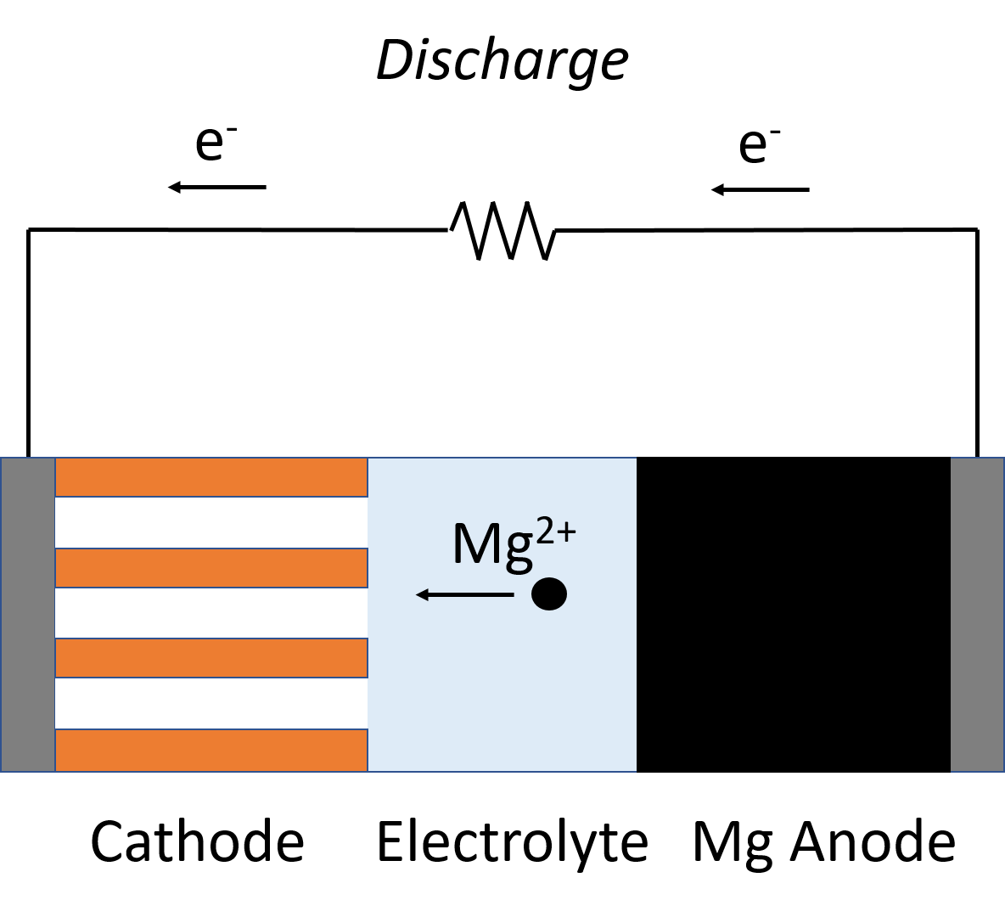
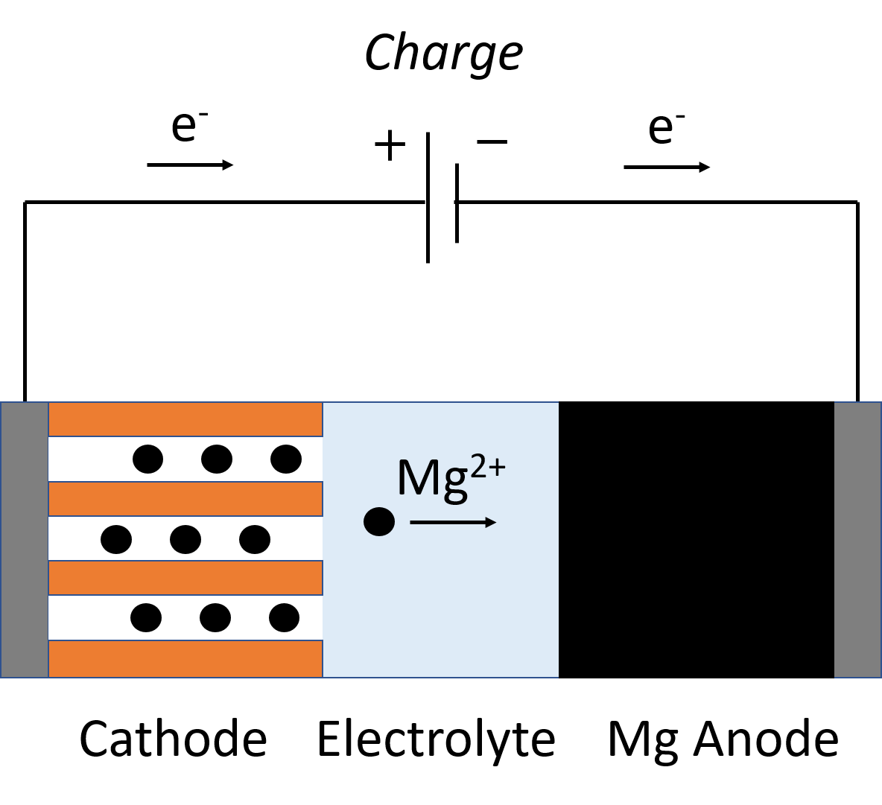
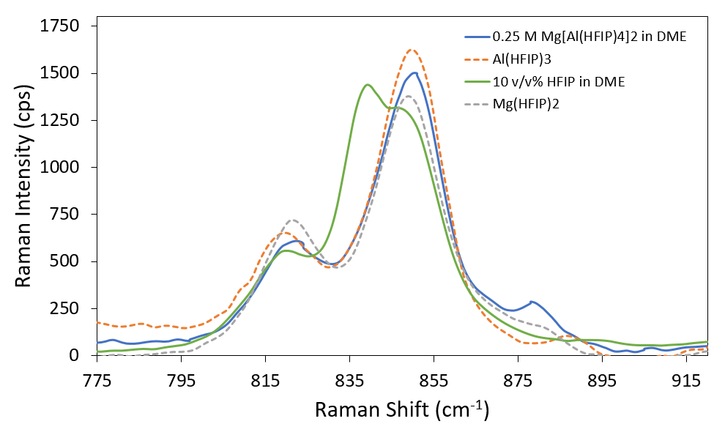
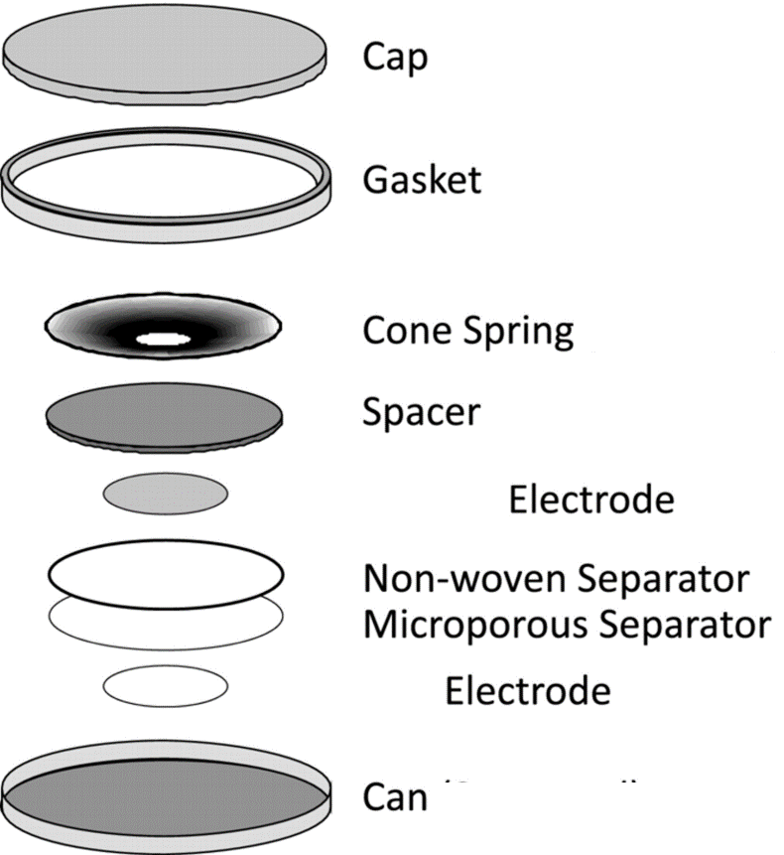
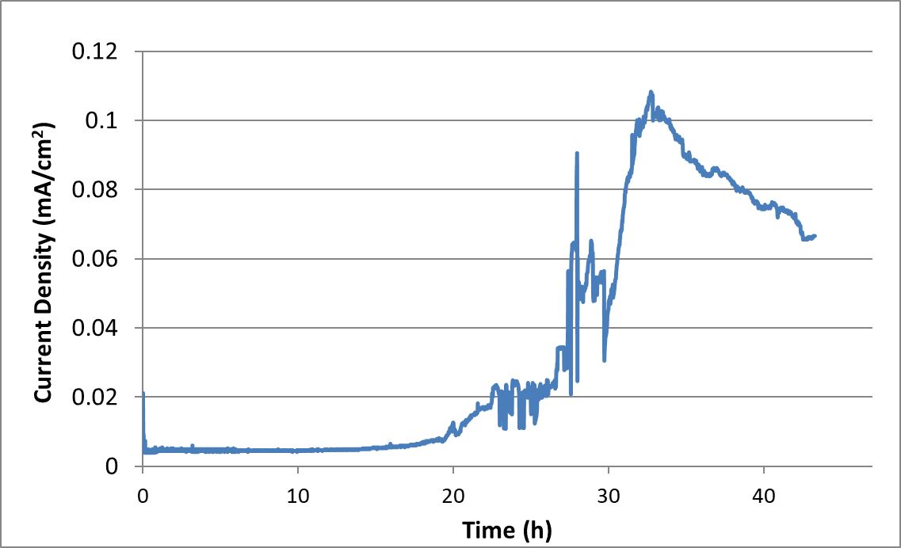
Electrochemical Analysis of an Electrolyte for Magnesium-Ion Batteries¹
Jake Herb^{a,b}, Anushka Dasgupta^{b}, Craig Arnold^{c}
ª Department of Chemistry ^{b} Department of Chemical and Biological Engineering ^{c} Princeton Institute for the Science and Technology of Materials
Project Overview
Solvation of Mg²⁺ Cations
A Full Battery
Challenges for magnesium-ion electrolytes?
The lack of electrolytes that simultaneously possess high Coulombic efficiency, conductivity, and voltage stability has hindered the deployment of rechargeable magnesium-ion batteries. The tenacious oxide layer on magnesium metal has limited the scope of research to halide ion-based electrolytes^{2,3,4}, which limit the working voltage window considerably.
Constraints and Challenges
H₂O
No aqueous solutions
AlCl₃
Corrosion at higher cell potentials
MgClO₄
Simple salt solutions do not facilitate Mg electrodeposition
The peak in the spectrum at 875 cm⁻¹ is shown in literature to result from the presence of Mg²⁺ ions encaged by solvent molecules.
This work
A new magnesium electrolyte previously developed in the Arnold Lab by Dr. Jake Herb¹ is synthesized and tested. A solution of fluoroalkoxyaluminate anions in DME solvent , it is shown to reversibly deposit magnesium metal with near unit efficiency in addition to achieving suitable oxidative stabilities (>3.5 V vs Mg/Mg²⁺ on glassy carbon and gold) and conductivities (>6 mS cm⁻¹).
High Anodic Stability
Conclusion
Weakly coordinating [Al(HFIP)₄]−anions show reversible plating and stripping of magnesium with high coulombic efficiency. In addition, their high conductivity and anodic stability make them promising candidates for high voltage Mg-Ion batteries.
Synthesis
To a cooled mixture of 1,1,1,3,3,3 Hexafluoroisopropanol (HFIP) in Dimethylether (DME) we added Trimethylaluminium.
To a mixture of HFIP in DME we added magnesium methoxide.
The precursors (1) and (2) were mixed in a 1:2 molar ratio and dissolved in DME. The initially cloudy mixture turned clear after stirring for 96 hours.
References
3.5 V Potential Hold
0.25 M Mg[Al(HFIP)₄)₂ in DME
99.999% Al
Herb J. T. ; Nist-Lund, C. A. ; Arnold, C.B. ACS Energy Lett. 2016, 1, 1227-1232.
Liao, C.; Guo, B.; Jiang, D.; Custelcean, R.; Mahurin, S. M.; Sun, X.-G.; Dai, S; J. Mater. Chem. A 2014, 2, 581−584.
Herb, J. T.; Nist-Lund, C.; Schwartz, J.; Arnold, C. B. ECS Electrochem. Lett. 2015, 4, A49−A52.
Muldoon, J.; Bucur, C. B.; Oliver, A. G.; Zajicek, J.; Allred, G. D.; Boggess, W. C. Energy Environ. Sci. 2013, 6, 482−487.
Materials and Methods
HFIP=
Acknowledgements
The Princeton Environmental Institute funded work on this project during the summer and the School of Engineering and Applied Sciences supported this work during the academic year through the Lidow Thesis Fund. The authors acknowledge Elizabeth Seibel and Kristen Baroudi of the Cava Lab at Princeton University for their assistance in the preparation and characterization of Mo₆S₈.
Control
3.0V
3.5V
Even in long-term tests, the electrolyte is stable at voltages well above 3.0V on Aluminum metal.
Arnold Lab

